Slide 1
Rhythmic Tune: Your Melodic Companion
Transforming your musical journey with intuitive design and seamless functionality.

Slide 2

Introduction to Rhythmic Tune
Welcome to the future of music interaction. Rhythmic Tune is designed to be your ultimate melodic companion, seamlessly integrating into your daily life. It offers a unique blend of intuitive design, powerful features, and an unparalleled user experience, making music creation and enjoyment more accessible than ever.

Slide 3




Key Features and Components
Intuitive Interface
Effortless navigation and a clean layout make finding and creating music a joy, not a chore.
Advanced Customisation
Personalise your sound with integrated equalisers, effects, and mixing tools.
Seamless Cloud Sync
Access your playlists and projects across all your devices, anytime, anywhere.
Collaborative Tools
Share and collaborate on musical projects with friends and fellow artists in real-time.

Slide 4
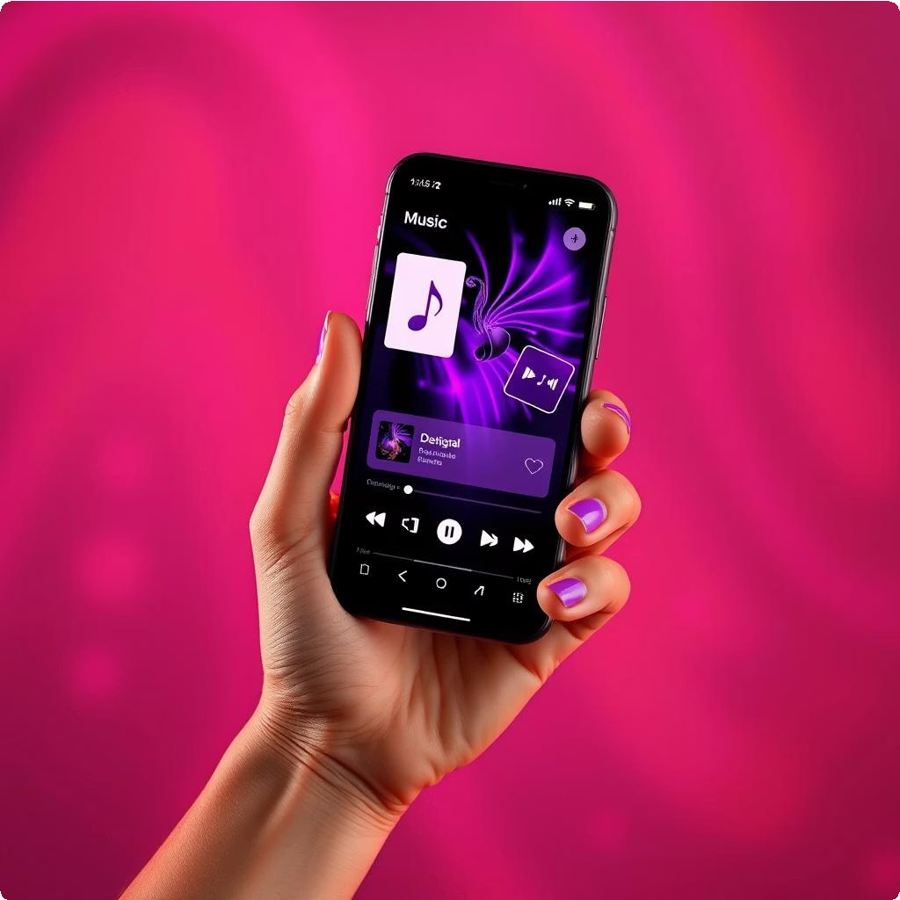
Transformative Benefits for Users
Rhythmic Tune offers a multitude of benefits, enhancing both casual listening and professional music production:
Enhanced Creativity: Unlock new possibilities for composition and arrangement.
Uninterrupted Flow: Experience music without lag or connectivity issues.
Personalised Experience: Tailor your musical journey to your unique preferences.
Global Community: Connect with a diverse community of music lovers and creators.

Slide 5
Design and User Experience Philosophy
Simplicity
1
Clean and uncluttered interfaces.
2
Accessibility
Designed for users of all skill levels.
3
Responsiveness
Fluid and adaptable across devices.
4
Innovation
Continuously evolving with new features.
Our design ethos is rooted in creating a seamless, enjoyable, and powerful user experience. We believe that technology should serve creativity, not hinder it.

Slide 6
Who is Rhythmic Tune For?
Aspiring Musicians
Casual Listeners
Utilise intuitive tools for composition and practice.
Enjoy a vast library of music with personalised recommendations.
Professional Producers
Music Educators
Leverage advanced features for mixing, mastering, and collaboration.
Integrate interactive lessons and shared projects into curricula.
Rhythmic Tune caters to anyone with a passion for music, from beginners taking their first steps to seasoned professionals perfecting their craft.

Slide 7
Advantages and Disadvantages
Advantages
High-fidelity audio streaming.
Extensive genre coverage and deep customisation.
Cross-platform compatibility for seamless use. Robust community and collaboration features.
Disadvantages
Requires stable internet for cloud features.
Advanced features may have a learning curve for new users.
Subscription model for full feature access.
We continually work to minimise disadvantages and maximise the user experience based on feedback.

Slide 8
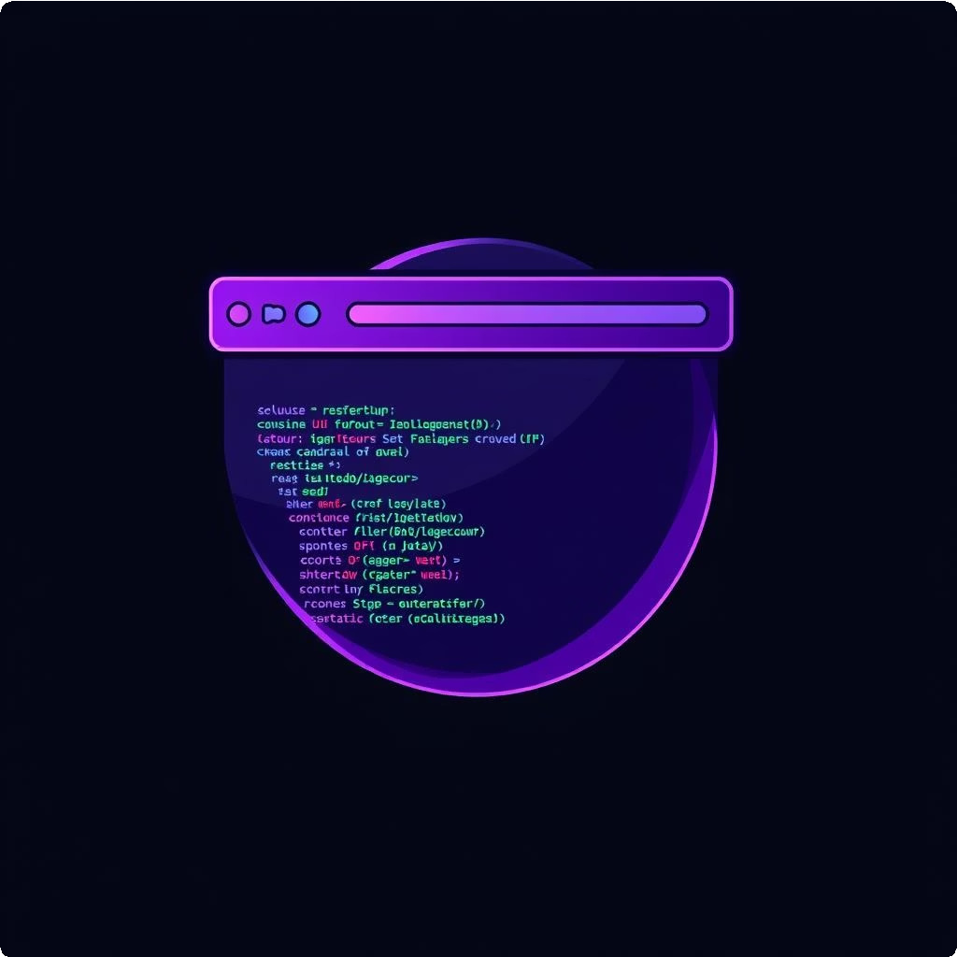

Under the Hood: Frontend and Backend
Frontend Architecture
Backend Infrastructure
The user interface is built with React Native, ensuring a smooth and responsive experience across iOS, Android, and web. This allows for rapid development and consistent UI/UX.
Our robust backend is powered by Node.js and a scalable PostgreSQL database, hosted on AWS. This setup supports real-time collaboration, large media storage, and secure user data management.
This strong technical foundation allows Rhythmic Tune to deliver high performance and reliability.

Slide 9
Conclusion: Harmonising Your Musical World
Rhythmic Tune is more than just an app; it's a comprehensive
ecosystem designed to enrich every aspect of your musical
journey. From discovery and
listening to creation and collaboration, we aim to be your essential melodic companion.
Join us in shaping the future of music.

Slide 10
Thank You!

